Slide 1
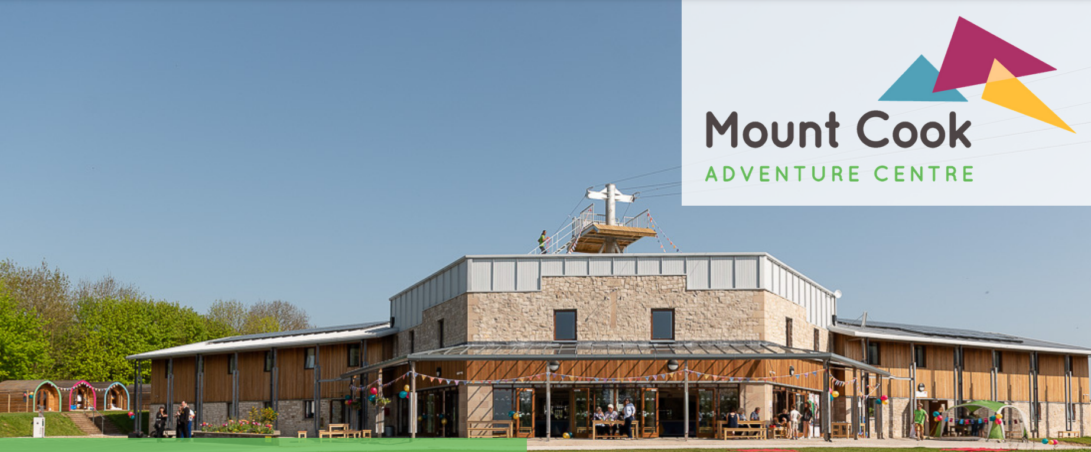

Slide 2
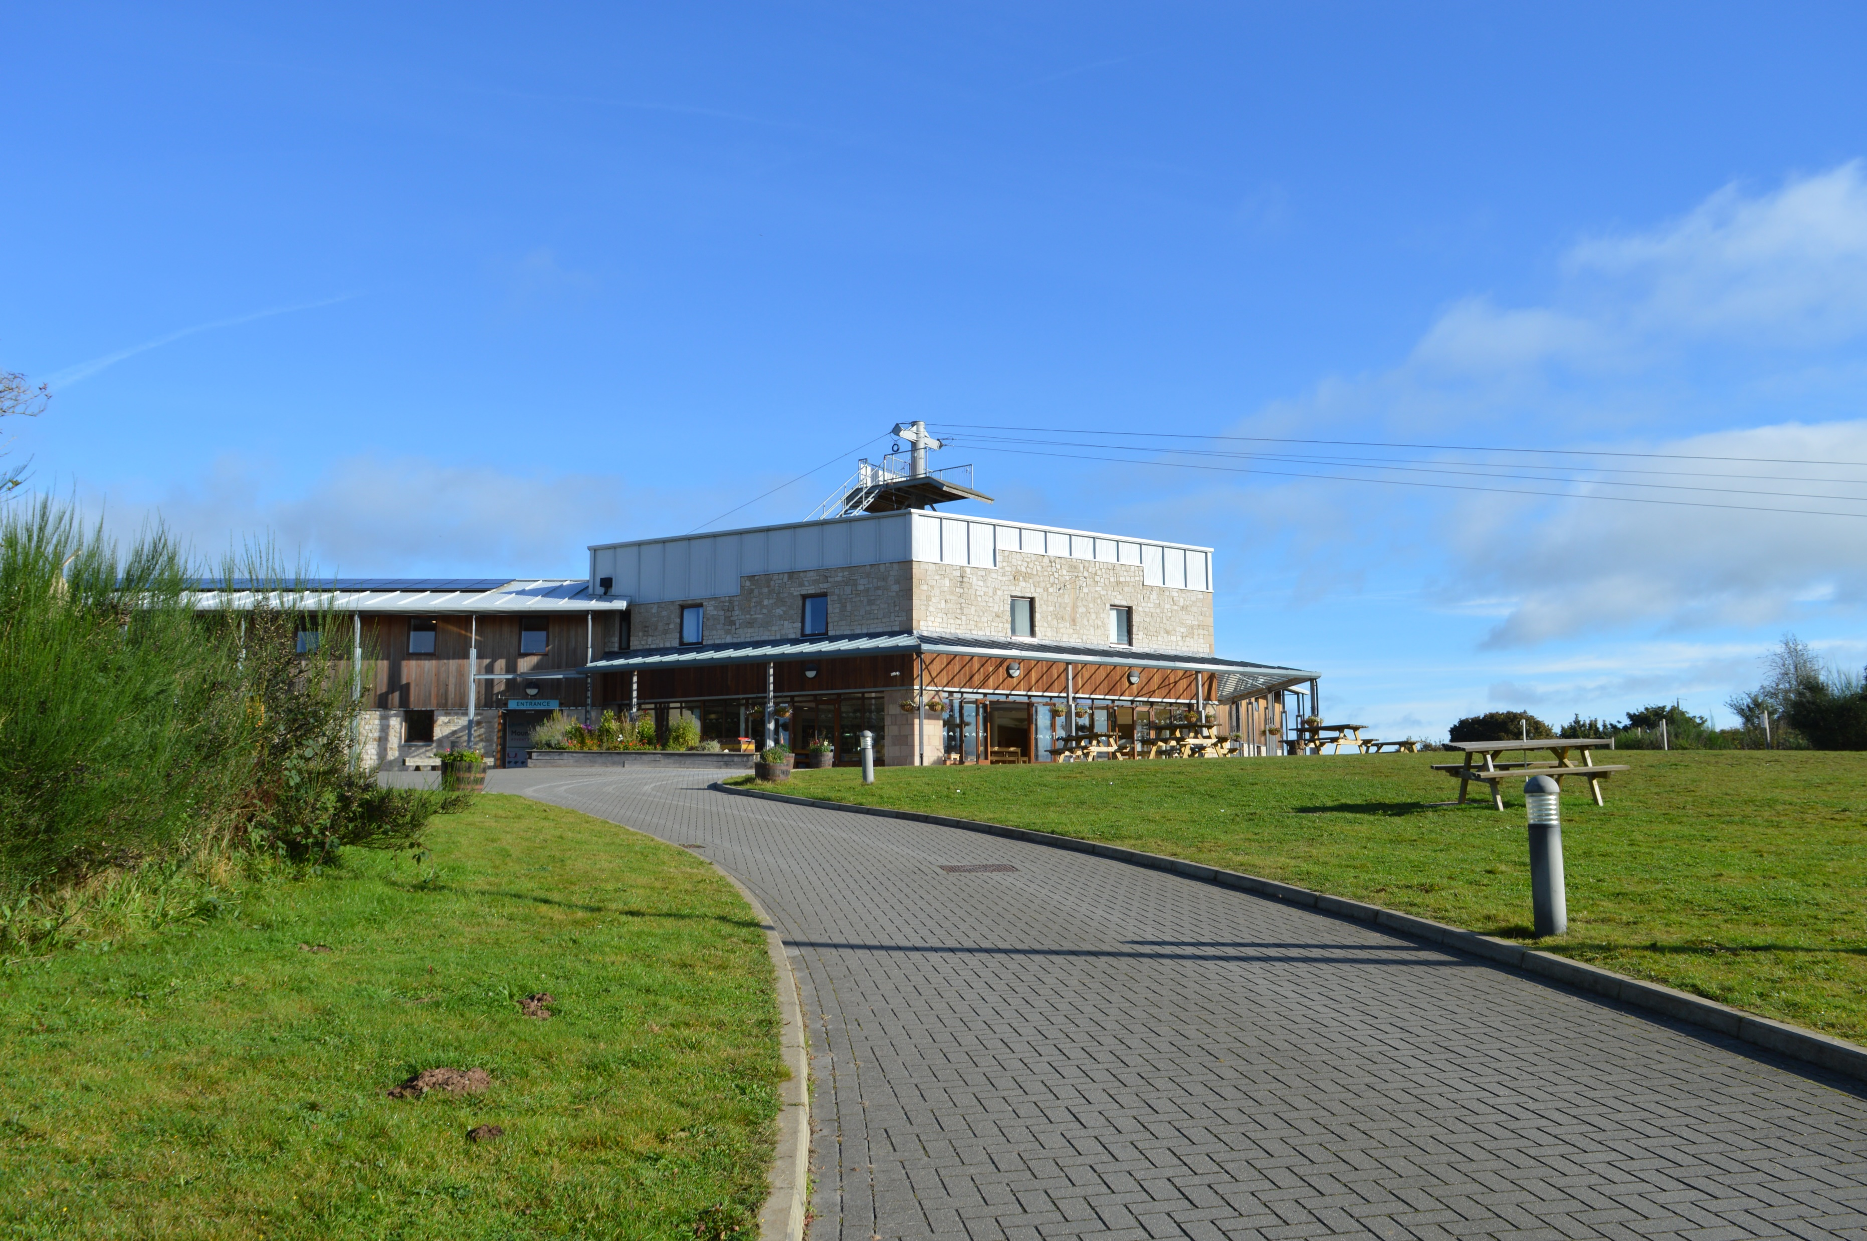
Mount Cook Adventure Centre
Porter Lane, Middleton-by-Wirksworth, Matlock, Derbyshire, DE4 4LS

Slide 3
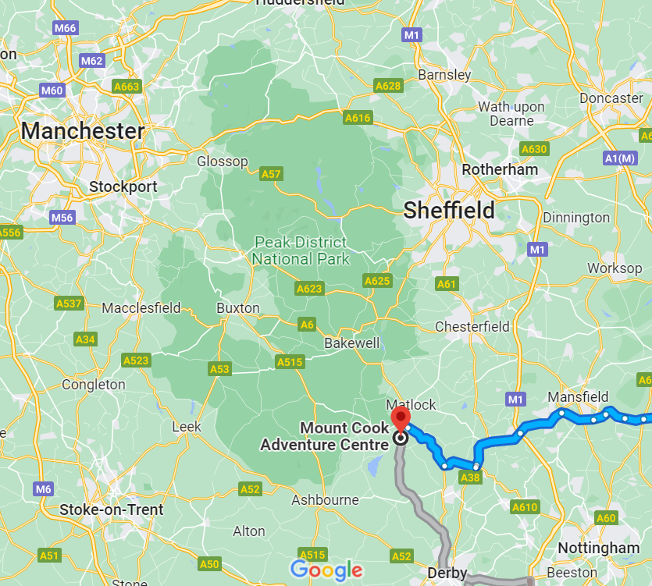
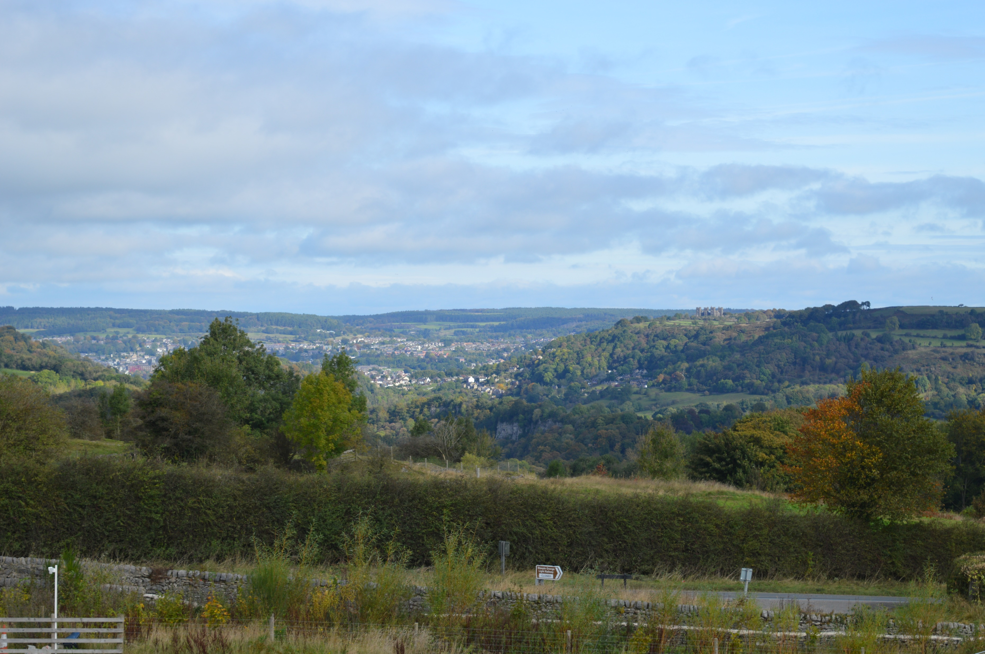
Where is it?
Mount Cook is situated just south of Matlock and right on the Peak District border.

Slide 4
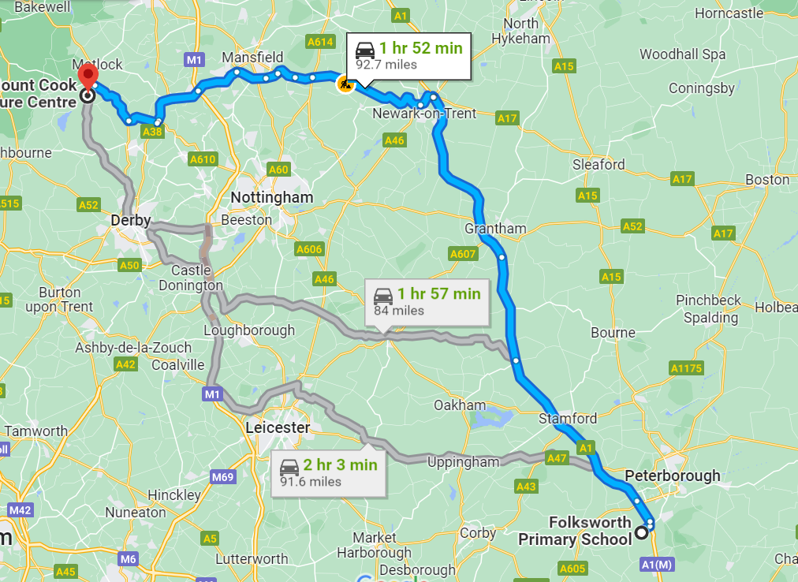
We are travelling with our usual coach provider Nationwide.
We will plan a toilet break midway.

Slide 5
Wednesday 30th March
Arrive at school for normal time in clothes ready for activities e.g. joggers, t-shirt, jumper.
On arrival, please hand Mrs Wright any medication (labelled and medical form with it). This also includes travel tablets for the return journey.
Please hand Mrs Sawyer £5 spending money in a named envelope.
Please bring a packed lunch and refillable water bottle. No chocolate, fizzy drinks etc… We hope to have a picnic near Mount Cook just before we arrive – weather depending.
We will aim to leave by 10:15 am – earlier if we can.

Slide 6
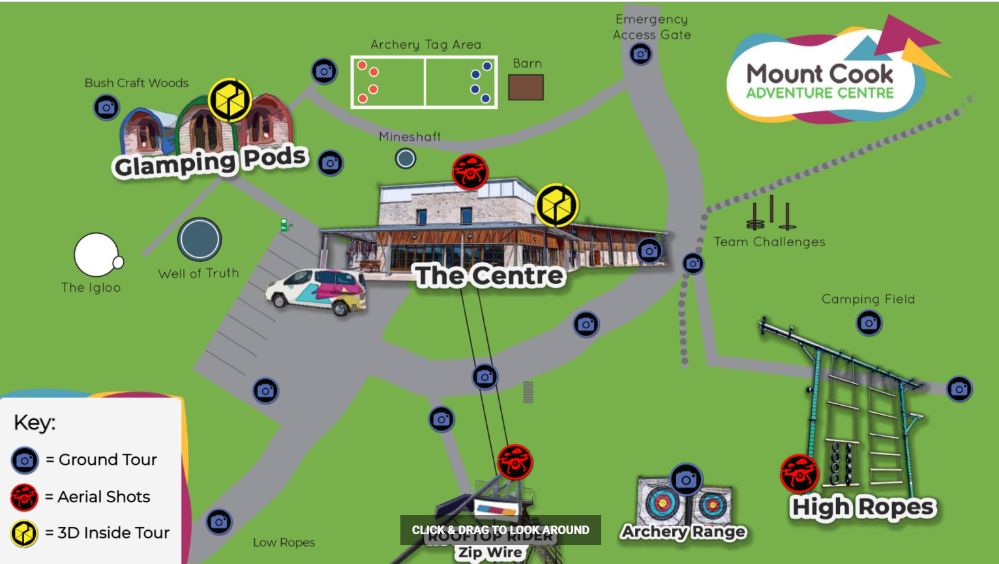
On arrival
Once we arrive at Mount Cook, we will be greeted by one of the leaders who will show us round and explain expectations for our visit. Below is a link to their virtual tour.
https://map.apollo3d.co.uk/share/collection/7PLvt?fs=1&vr=1&sd=1&thumbs=-1&chromeless=1&logo=1

Slide 7
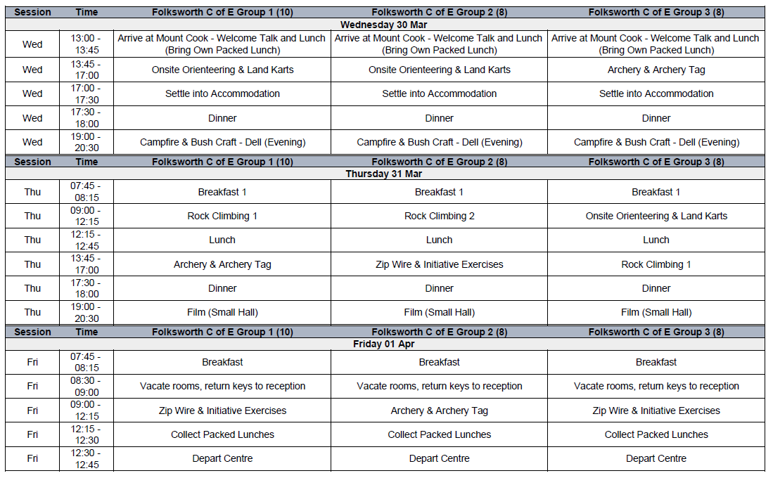
Itinerary for the three days

Slide 8
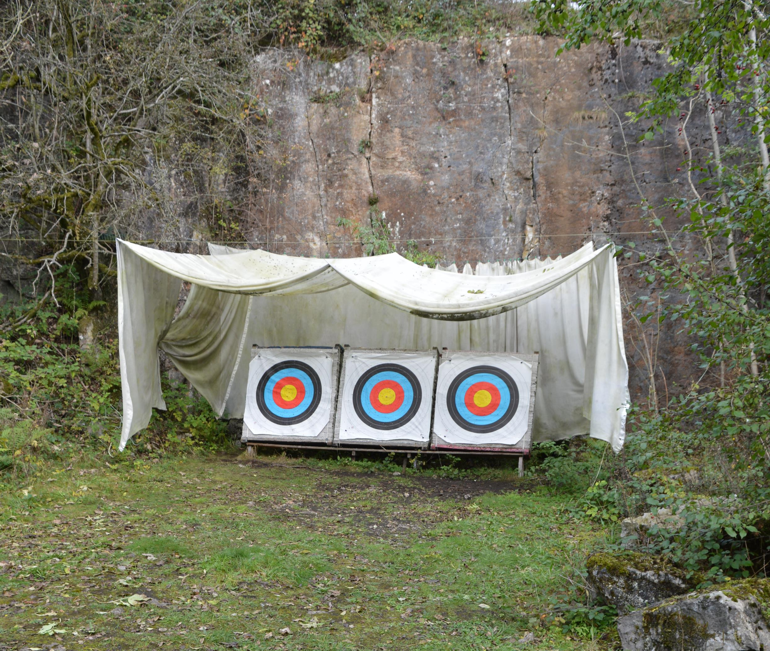
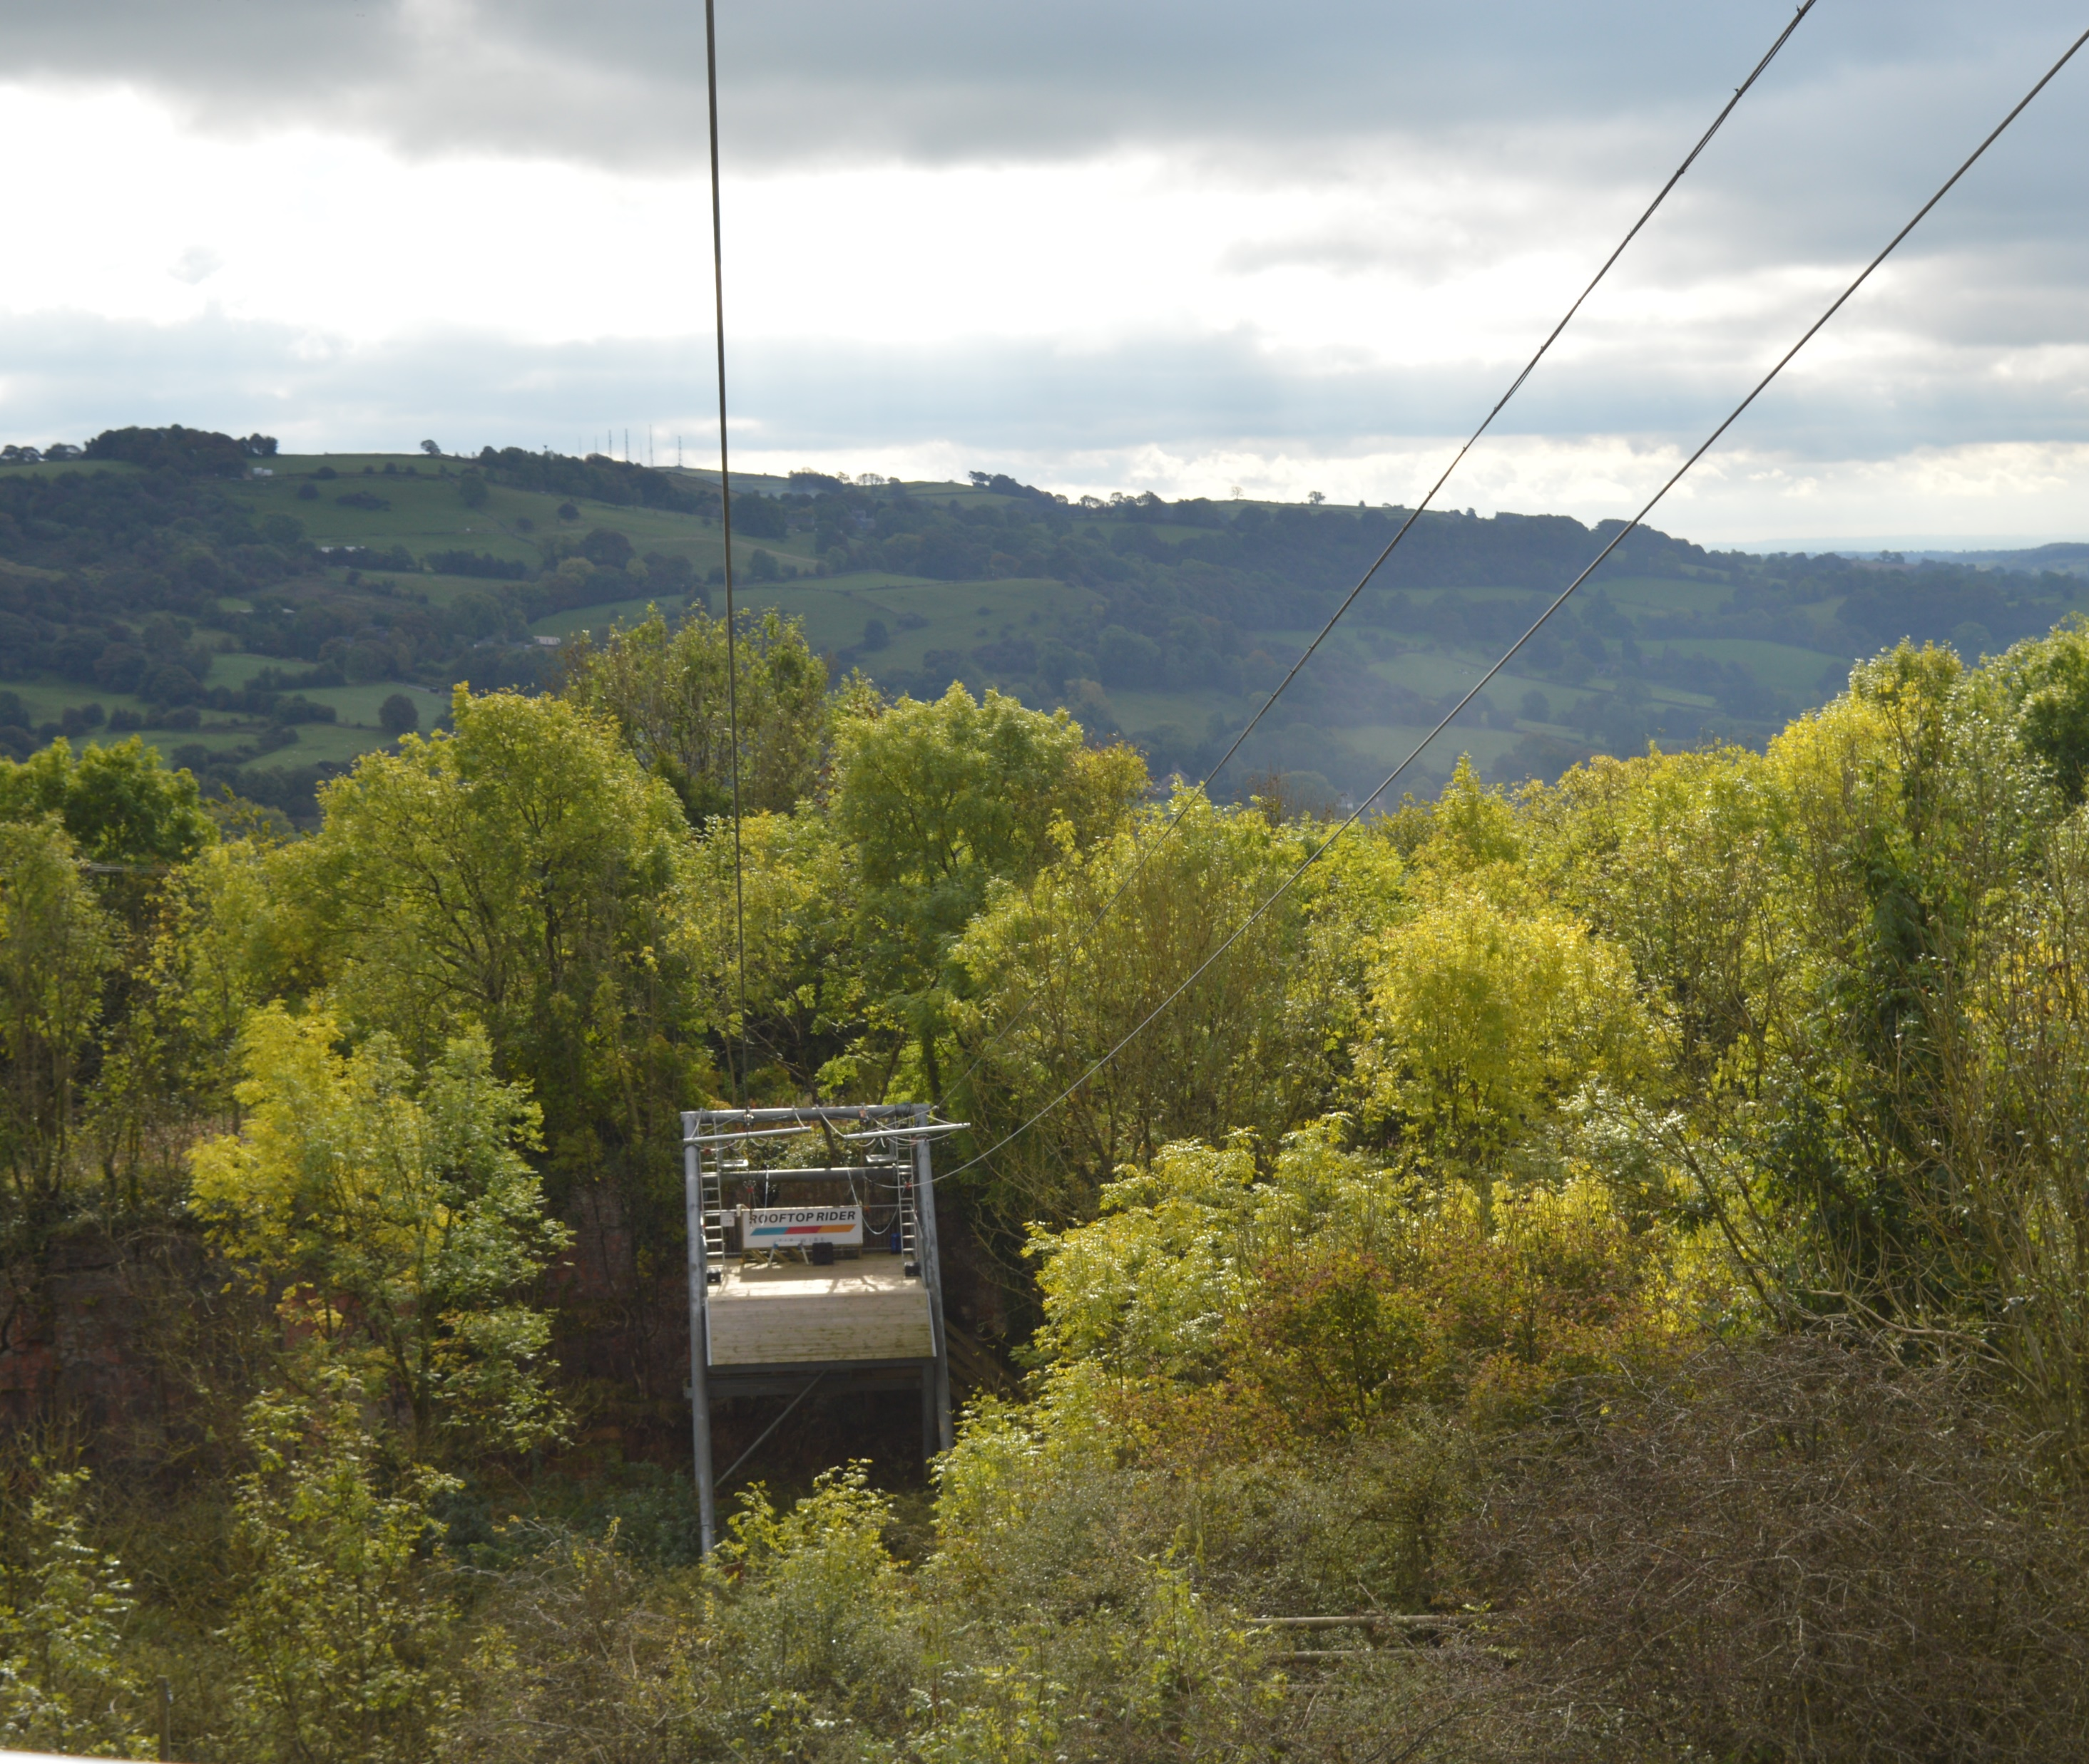
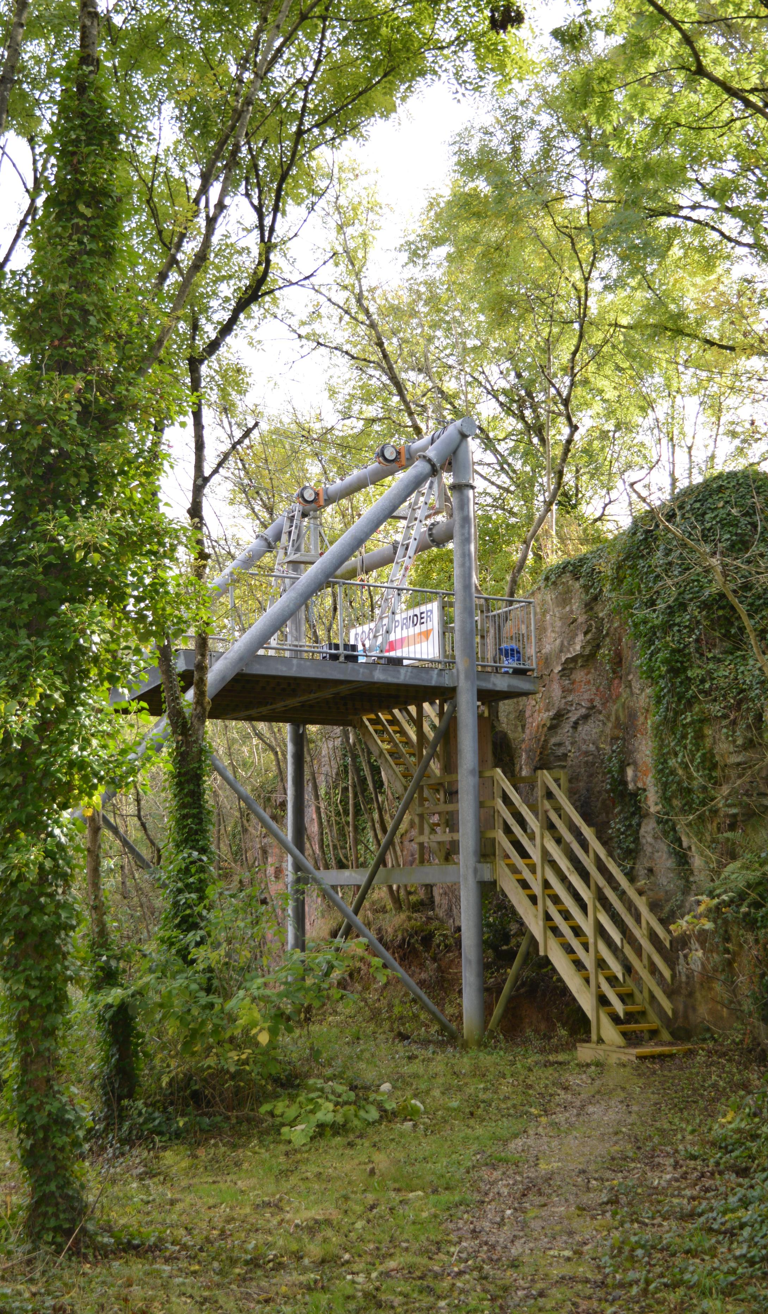
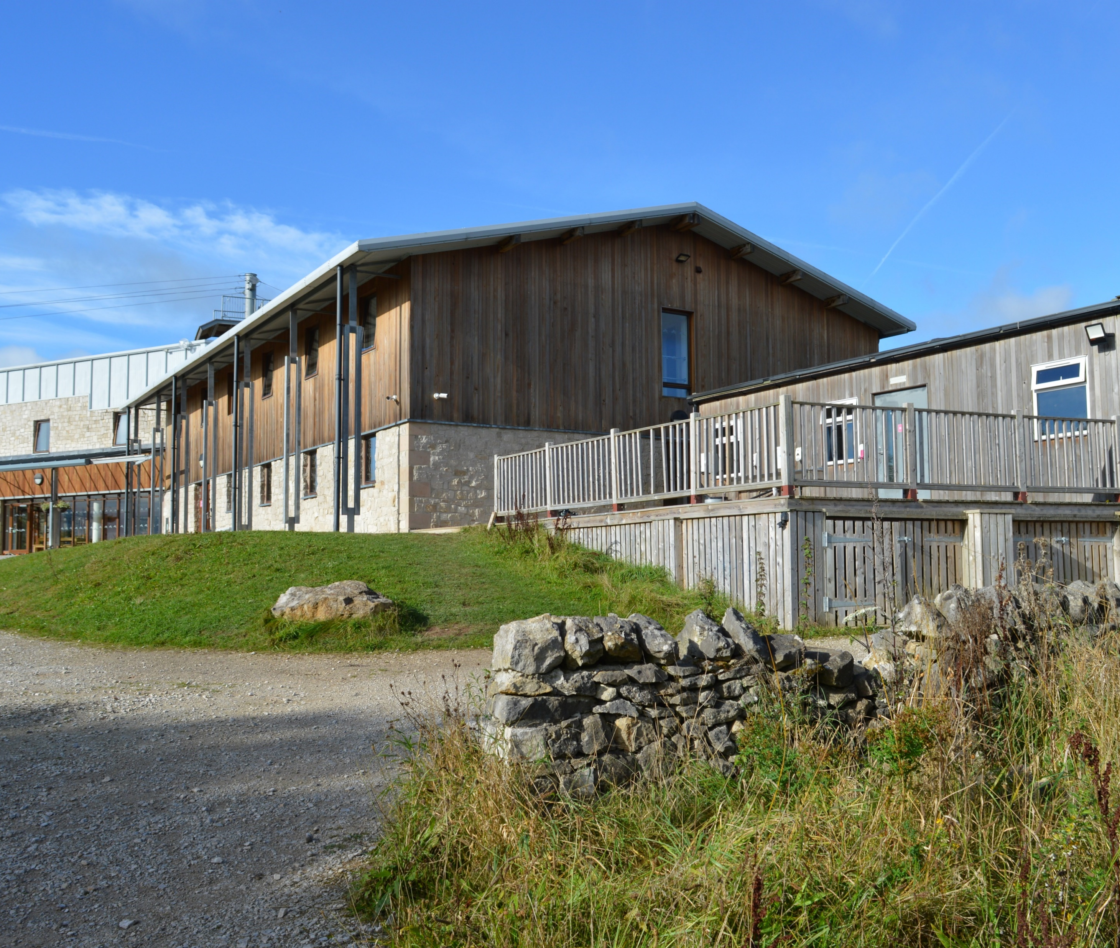
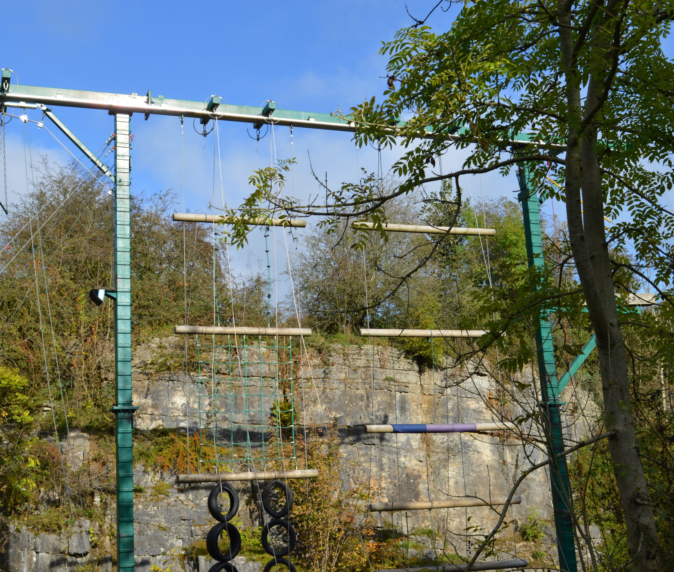

Slide 9
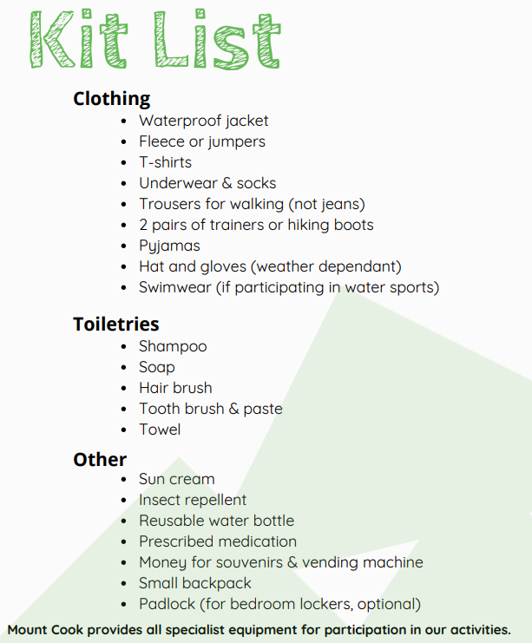
Kit List
The children will bring a copy of this home tomorrow.
Please note, we a not doing any water activities, no swimwear needed.

Slide 10
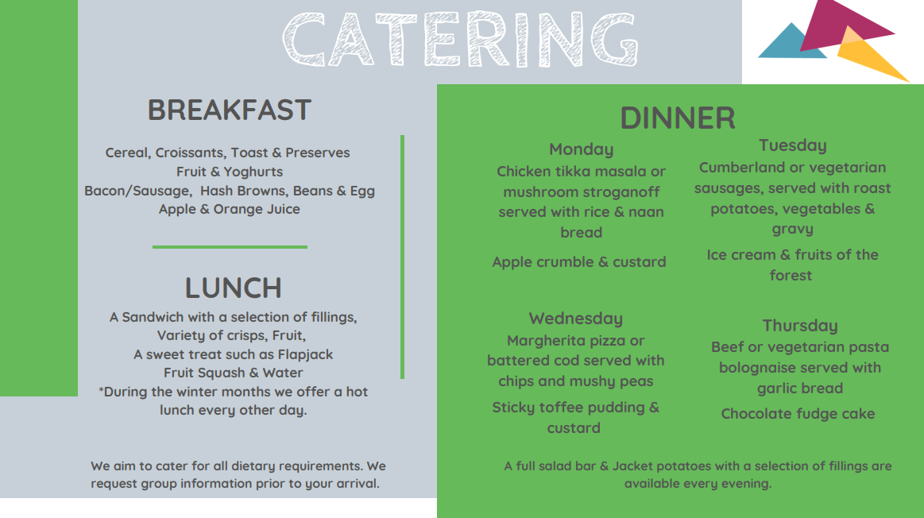
Example menu

Slide 11
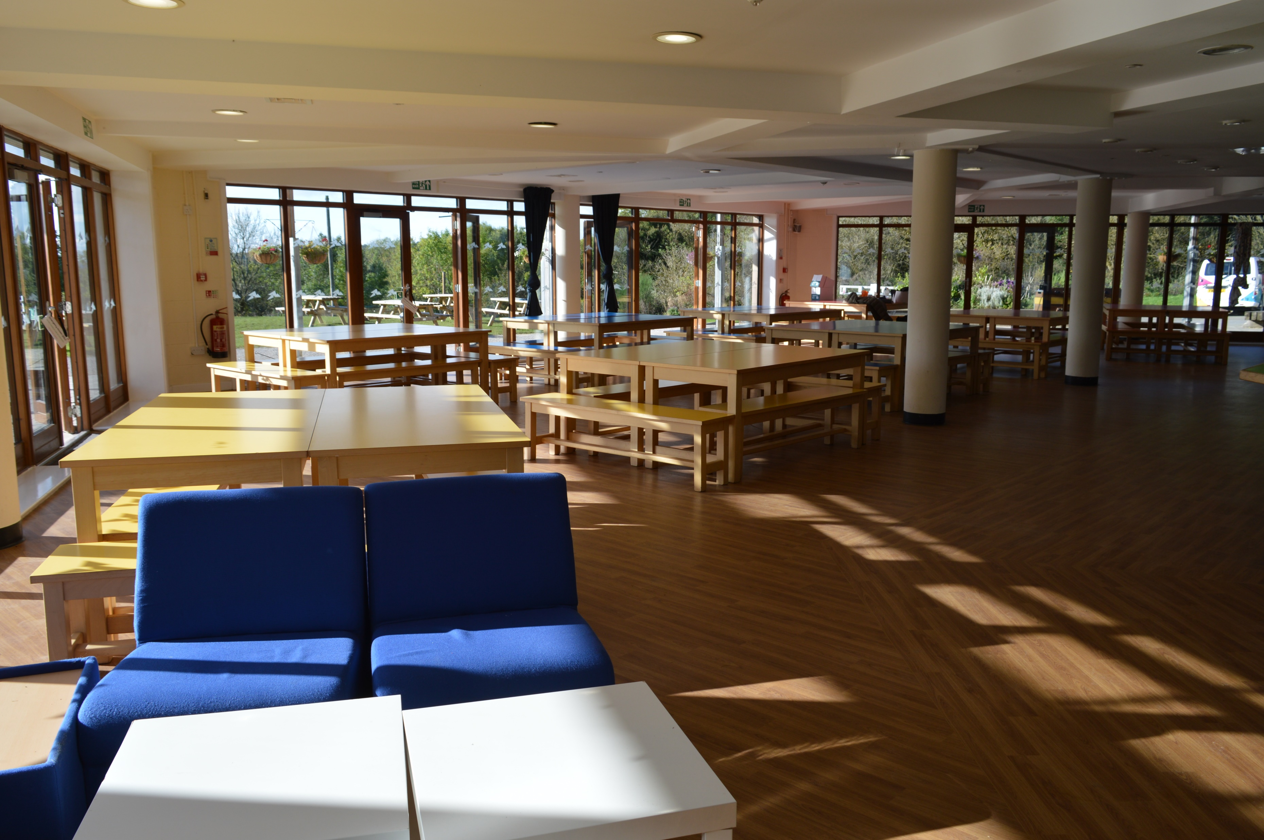
Dining Room

Slide 13
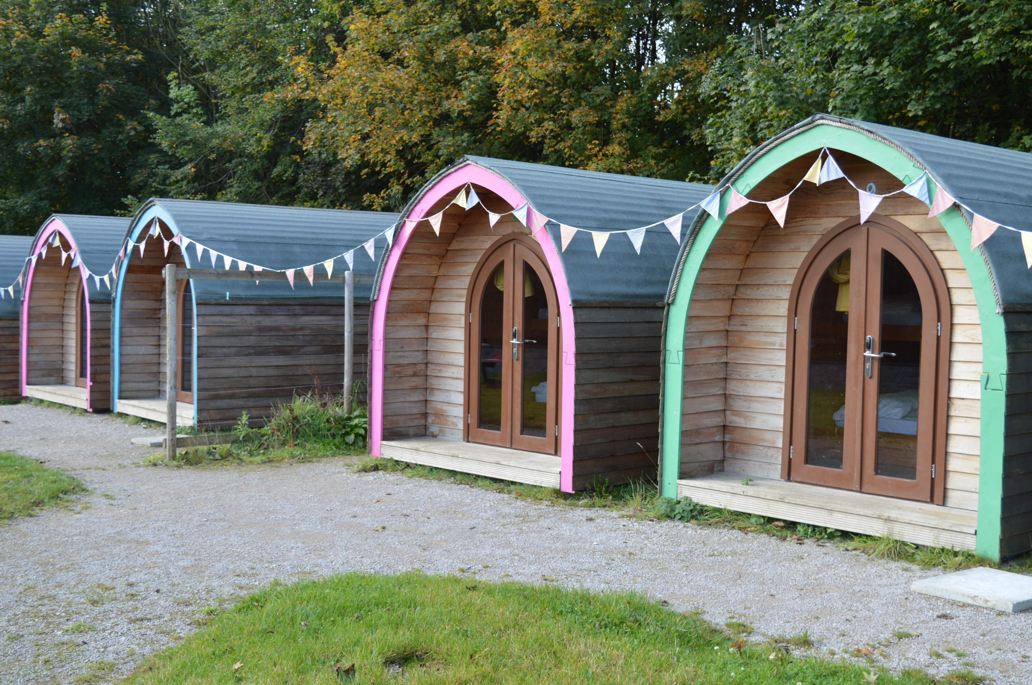

Slide 14
Return home – Friday 1st April
Leave after lunch approx. 12:30pm, aiming to be back by 3:00pm. We will keep you informed via Twitter if there are any delays.
Children must come into school straight off the coach, to ensure they have all their belongings, and any medication can be returned.
The children will be dismissed to their adult. Please notify school if there are any changes to the adult collecting.

