Slide 1

https://www.youngvoices.co.uk/

Slide 2

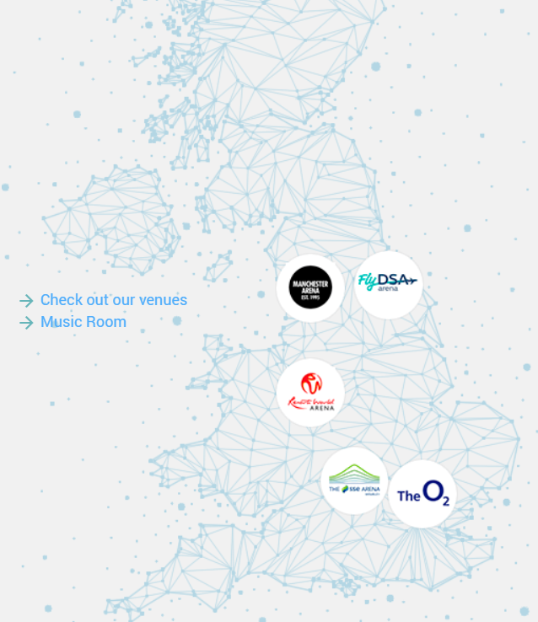
What is Young Voices?
It all started 25 years ago and since has become the worlds largest children’s choir, performing in arenas across England:
The O2 Arena, London
Resorts World Arena, Birmingham
Manchester AO Arena, Manchester
Utilita Arena, Sheffield
The SSE Arena, Wembley
Choirs will perform alongside 5,000-8,000 other children as a single choir to capacity audiences of family and friends.

Slide 3
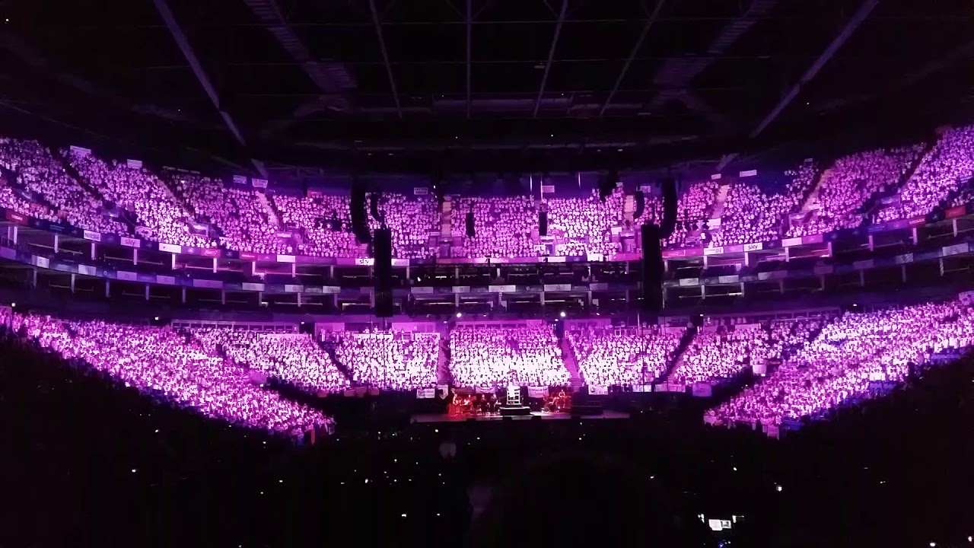
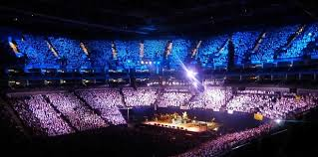
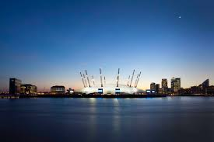
We have been practicing our songs and dance moves and are excited to see the famous artists also perform.
Venue:
London O2 Arena
Peninsula Square London
SE10 0DX

Slide 4
Timetable for the day
Coach arrives at 8:30am – aim to leave about 9am. Please arrive between 8:30 and 8:45am.
Estimated time of arrival 11:00am.
Toilet and look around the arena. Have lunch by the River Thames if the weather is nice.
1:30pm – register and take our seats.
2:15pm – 5:00pm - Rehearsals start.
5:00pm – 6:15pm – dinner time.
6:30 – return to seat ready to perform (every school will get a shout out between 6:30pm and 7pm so that as parents take their seats so you will be able to see where we are situated).
7:00pm – 9:00pm - Your Young Voices Concert (no interval)
9:00pm- Concert ends

Slide 5
End of the concert
Schools must remain in their seats until the very end of the concert. The arena staff will give you clear instructions on departure procedures.
We will return to the coach and travel back to school, you will be informed of our ETA, approx. 11:00pm.
This is also for children whose parents are attending the concert. It will be extremely difficult and time consuming to try and arrange to meet up with parents at the O2, so the safest and quickest way to reunite children with their parents is back at school.

Slide 6
What children need on the day
School uniform is to be worn, with a plain white t-shirt.
A packed lunch
Refillable water bottle
Food for ‘dinner’
Comfortable shoes
Medication i.e. inhaler, travel medication. Please give to Mrs Wright when you arrive at school.

Slide 7

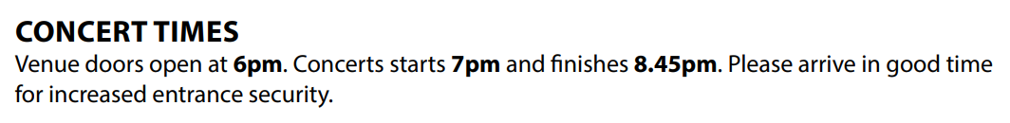

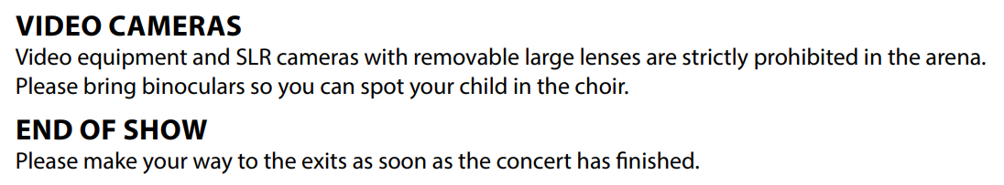
https://www.theo2.co.uk/visit-us/parking

Slide 8
