Slide 1
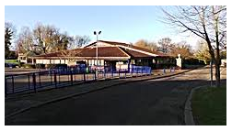

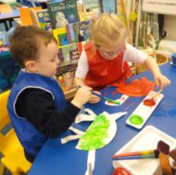
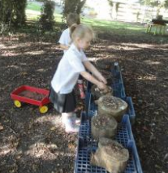
Welcome to Folksworth C of E Primary School.
Intake September 2018

Slide 2
Who is who?
Headteacher – Miss Michelle Norbury
Deputy Headteacher and EYFS Lead – Mrs Nikki Sawyer
Class Teacher – Miss Bernadette DeMassimi (will be Mrs Ducket in September)
Teaching Assistant – Mrs Carolyn Lynn
Chair of Governors – Mrs Clare Kirk
Finance Manager – Mrs Caroline Munroe
Secretary – Mrs Michelle Esposito
Early Birds / Stay and Play Manager – Mrs Wendy Reynolds
Chair of PTA – Mrs Nicci Yoder

Slide 3
Key Stage | Year group | Class name | Teacher
EYFS | Reception (Age 4 to 5) | Acorn | Miss DeMassimi (Mrs Ducket)
KS1 | Years 1 and 2 (Age 5 to 7) | Maple | Mrs Sawyer
KS2 | Years 3 and 4 (Age 7 to 9) | Oak | Mrs Daynes
KS2 | Years 5 and 6 (Age 9 to 11) | Elm | Mrs Perry

Slide 4
The story so far…
You were offered a place for your child.
You were invited to our picnic.
You were invited to our intake evening tonight.
What happens next?
We will visit pre-school settings.
You will be invited to attend 3 intake sessions.
We will carry out home visits if you would like one.
We are at the other end of the phone if you have any questions or concerns.

Slide 5
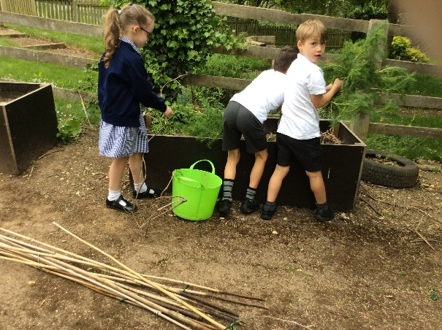
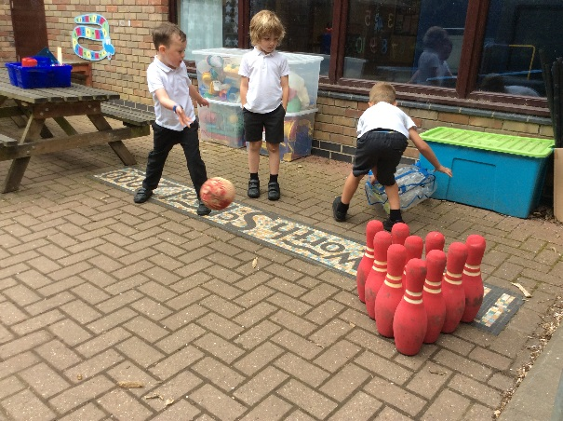
1. Personal, Social and Emotional Development
2. Communication and Language
3. Physical Development
4. Literacy
5. Mathematics
6. Understanding of the World
7. Expressive Arts and Design
Hands on activities
Real life experiences
Play based curriculum
Variety and choice to cater for different learning needs
Individualised and look at the interests of the child.
Delivered through

Slide 6

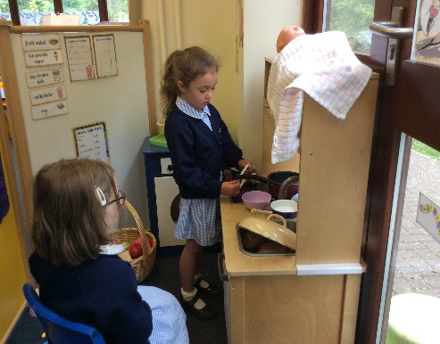
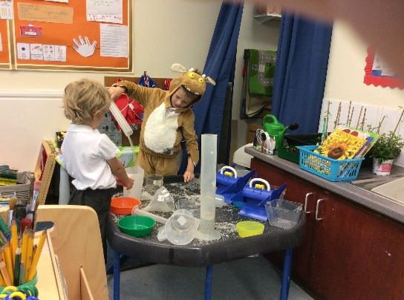

Independent learning through play both inside and outside.
Small group activities that are led by an adult such as a counting game.
Adult supported play where the adult plays with the child at their choice of activity.
Whole school activities such as going to assembly when they are ready.
Whole class activity such as PE or phonics.
1 to 1 activities with an adult such as sharing a story.

Slide 7
Turning their clothes the right way round.
Putting their own coat on and doing it up.
Tidy their toys away.
Go to the toilet by themselves
Recognising their name on their clothes.
Get dressed into their PE kit and back into their uniform.
Make their needs known
Wash their hands independently.

Slide 8




Uniform
Uniform can be ordered by completing the form in your pack.
Please name all pieces of uniform clearly.
Shoes – Velcro or buckles rather than laces unless they can do them up by themselves.
Hair longer than the top of the shoulders to be tied back.
No jewellery except stud earrings
Coat suitable for all weathers with a loop to hang it up by.
Shoes rather than boots inside

Slide 9
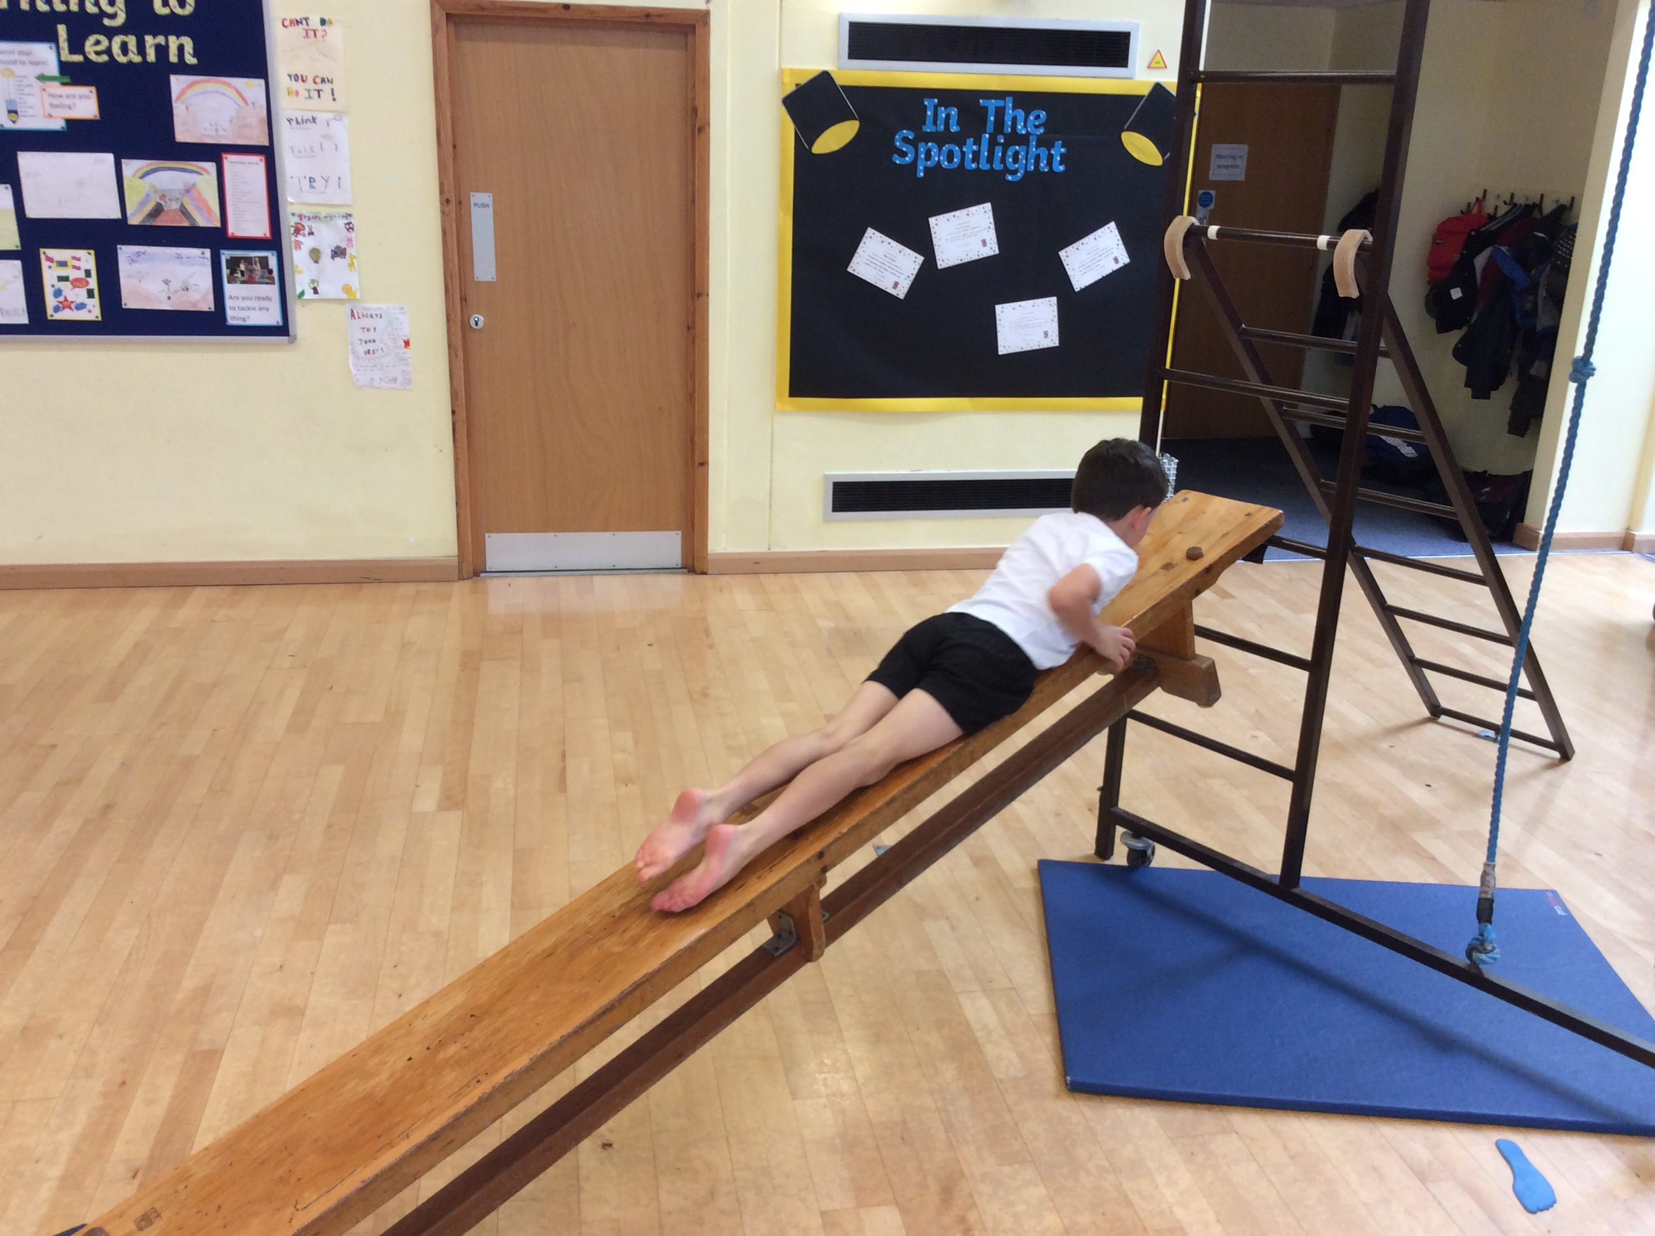
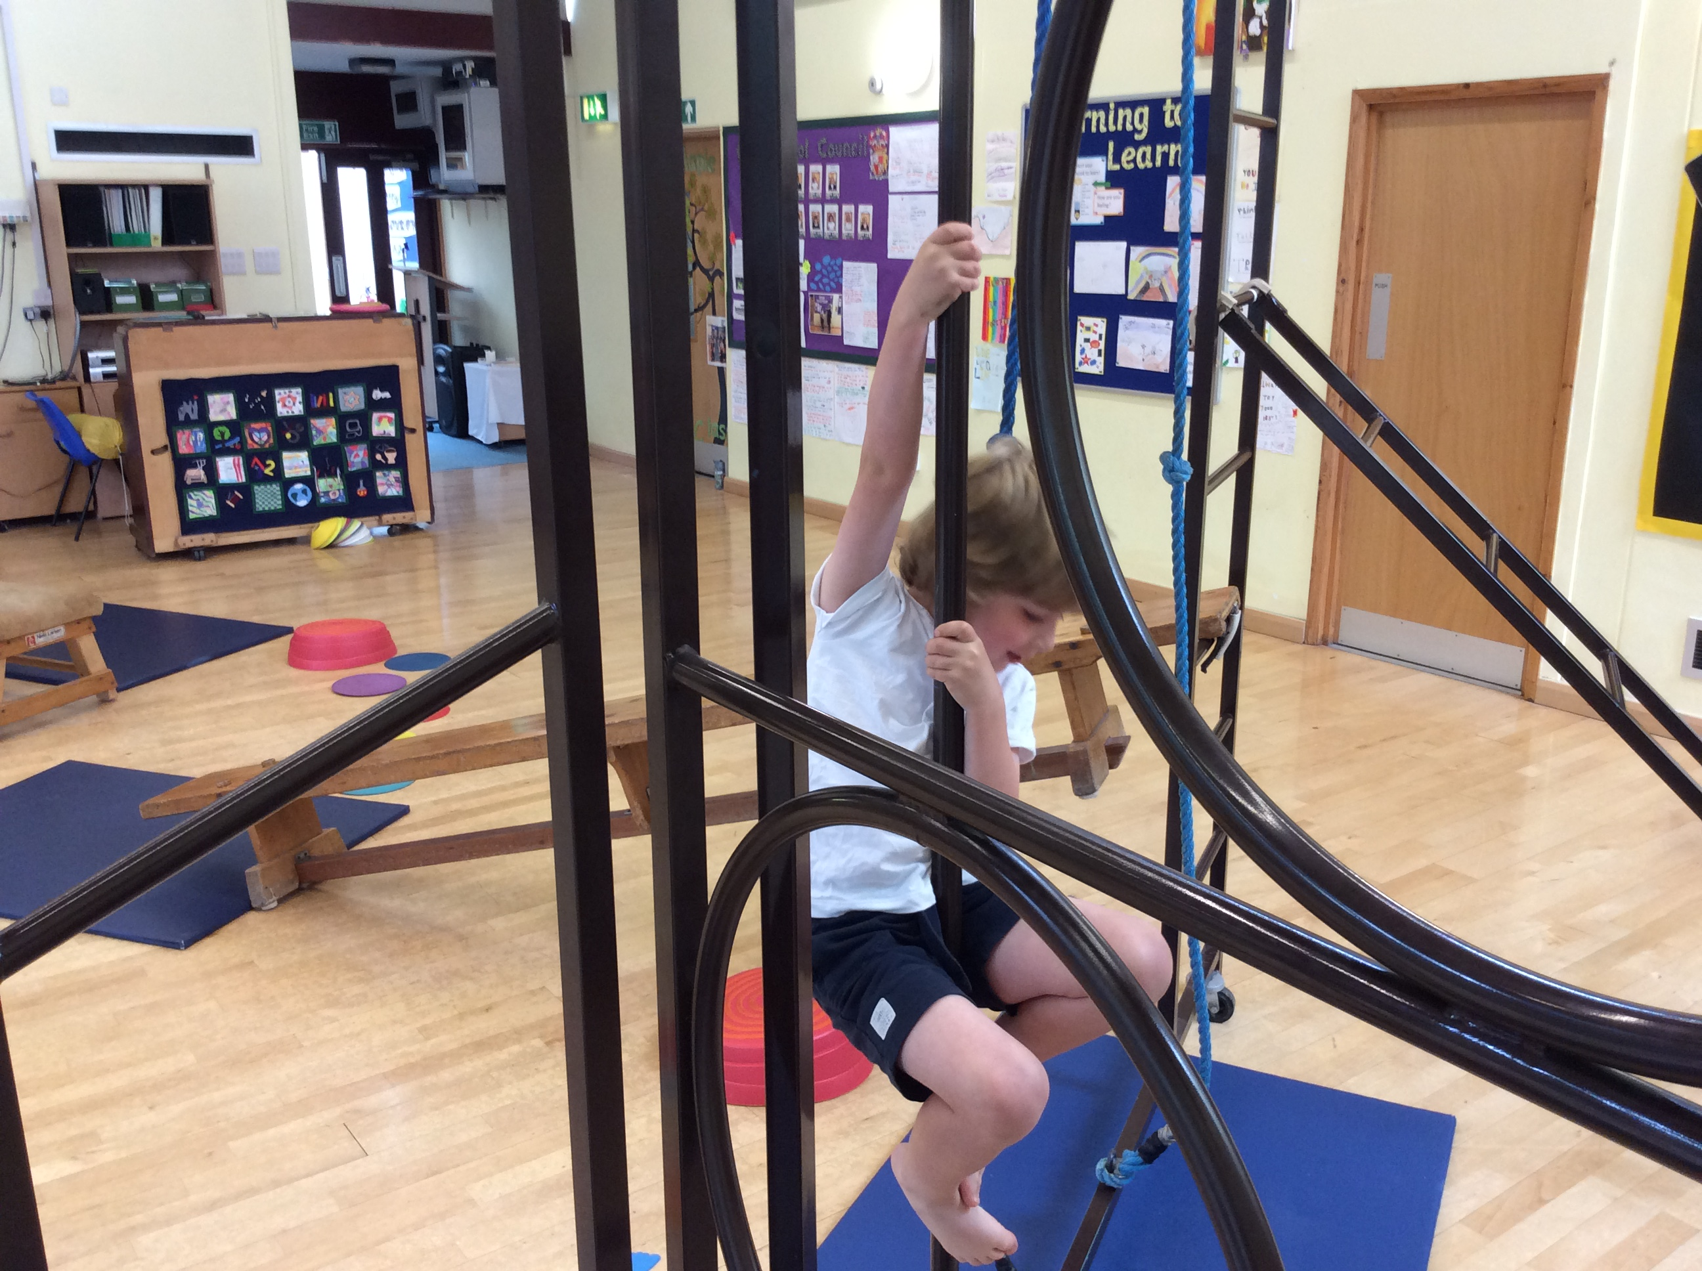
Indoor PE kit
White polo shirt or T-shirt
Black or navy shorts
Outdoor PE Kit
Black or navy track suit
Trainers
Change of socks

Slide 10
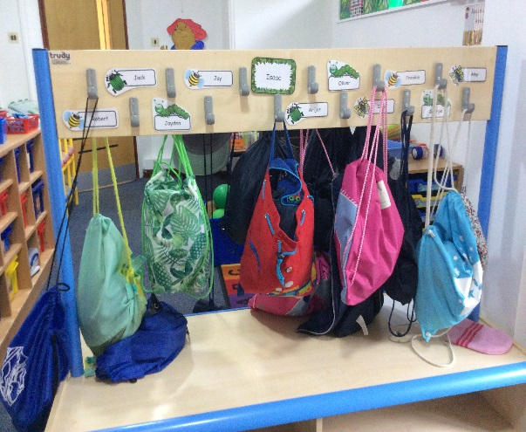
The first day!
Children will arrive ready for the whistle at 8.50am.
Staff will be in the playground to greet you and direct you round to the classroom entrance.
You will be welcomed in to the classroom with your child where they will be helped to find their peg and hang their coats up.
Please feel free to stay with your child until they are happy for you to leave.

Slide 11
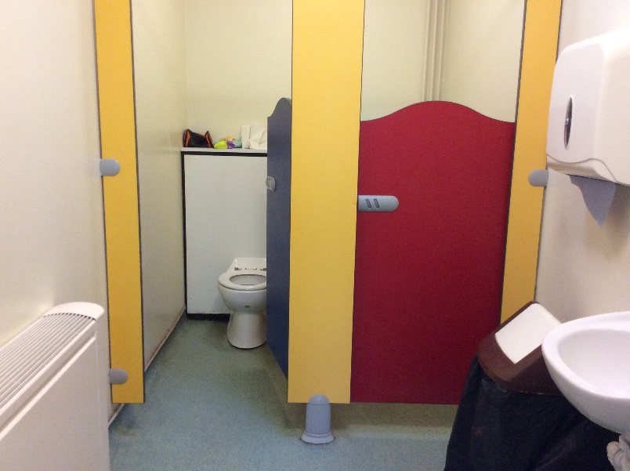
They toilets for our EYFS children are smaller in size.
Please let us know if your child has a concern or a problem regarding going to the toilet by themselves so that we can support this.
Children can go to the toilet at any time during the day.
Please provide spare pants and socks in case of accidents.

Slide 12
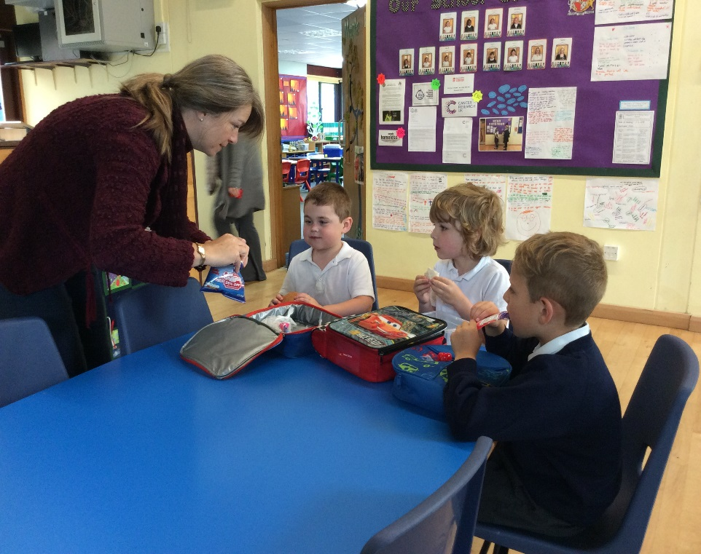
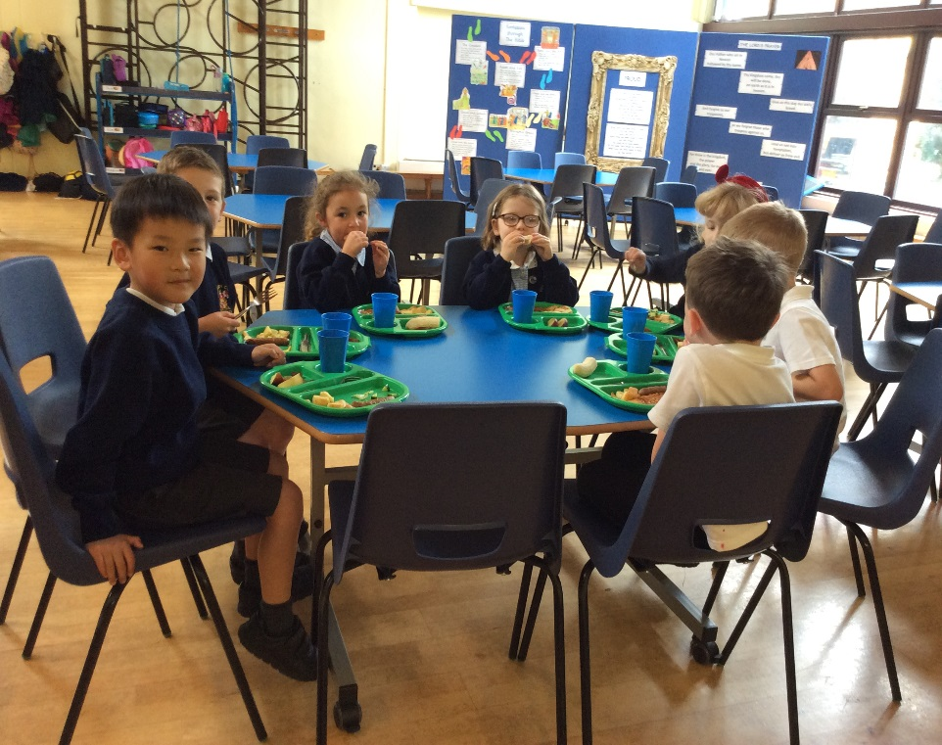
We produce hot school meals on site every day for our children.
A three week rotation menu is currently followed.
Children will also be provided with a free piece of fruit for snack.
They will also need to bring a NAMED water bottle each day so that they have access to a drink whenever they need one.

Slide 13
Absence and Illness
Obviously we try to keep this to a minimum and actively discourage holidays during term time. If any time away from school is required, a leave of absence form must have been completed in advance.
If your child is ill, please inform the office before school starts so that we know where every child is when we register them.
If they have had sickness or diarrhoea they must be kept at home for 48 hours after the last bout. This avoids other children and adults catching the bug!
If your child has any ongoing medical conditions that you would like to discuss with us, please let us know.

Slide 14


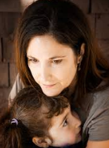
What can I do if my child is struggling?
Please come and talk to us if you are worried about anything at all.
Due to our small intake numbers, we do not stagger our intake. This means that all children can start full time from day one. However, if you feel that your child is struggling with this or they are getting very tired by the end of the week, flexible part time arrangements can be made.
Alternatively, if we feel that your child is flagging during the day, we may phone you to discuss whether you would like to consider picking them up at lunchtime or having a later start the following day.

Slide 15
