Slide 1

Grafham Water Residential
9th – 11th May 2022

Slide 2

Key Information
Staffing – Mrs Perry, Mrs Reynolds and Miss Norbury
Grafham Water Residential Centre
Pack own suitcase
Behaviour expectations

Slide 3
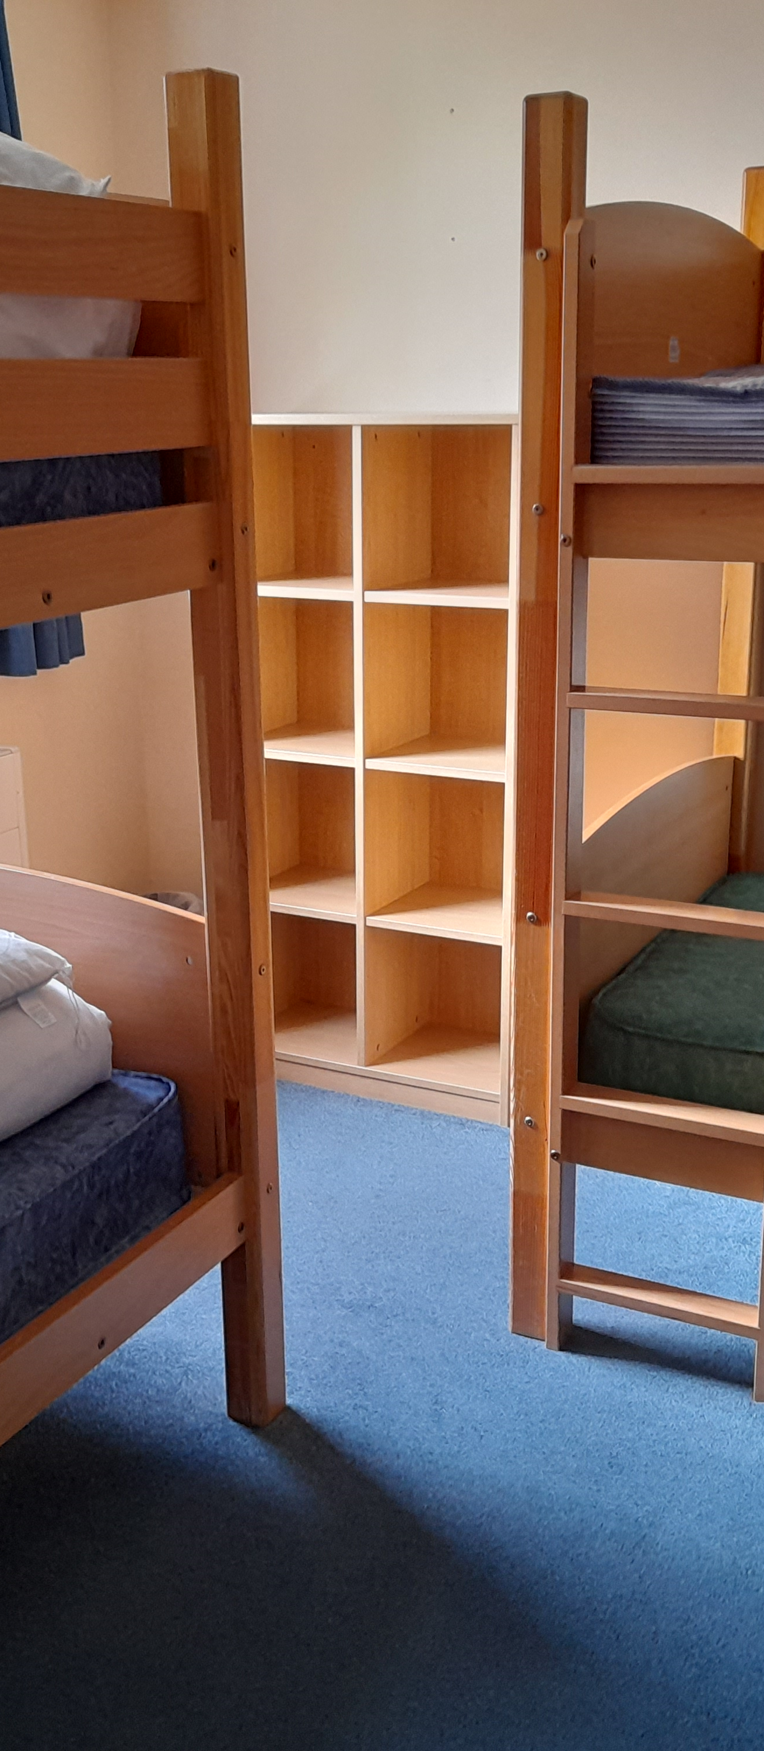
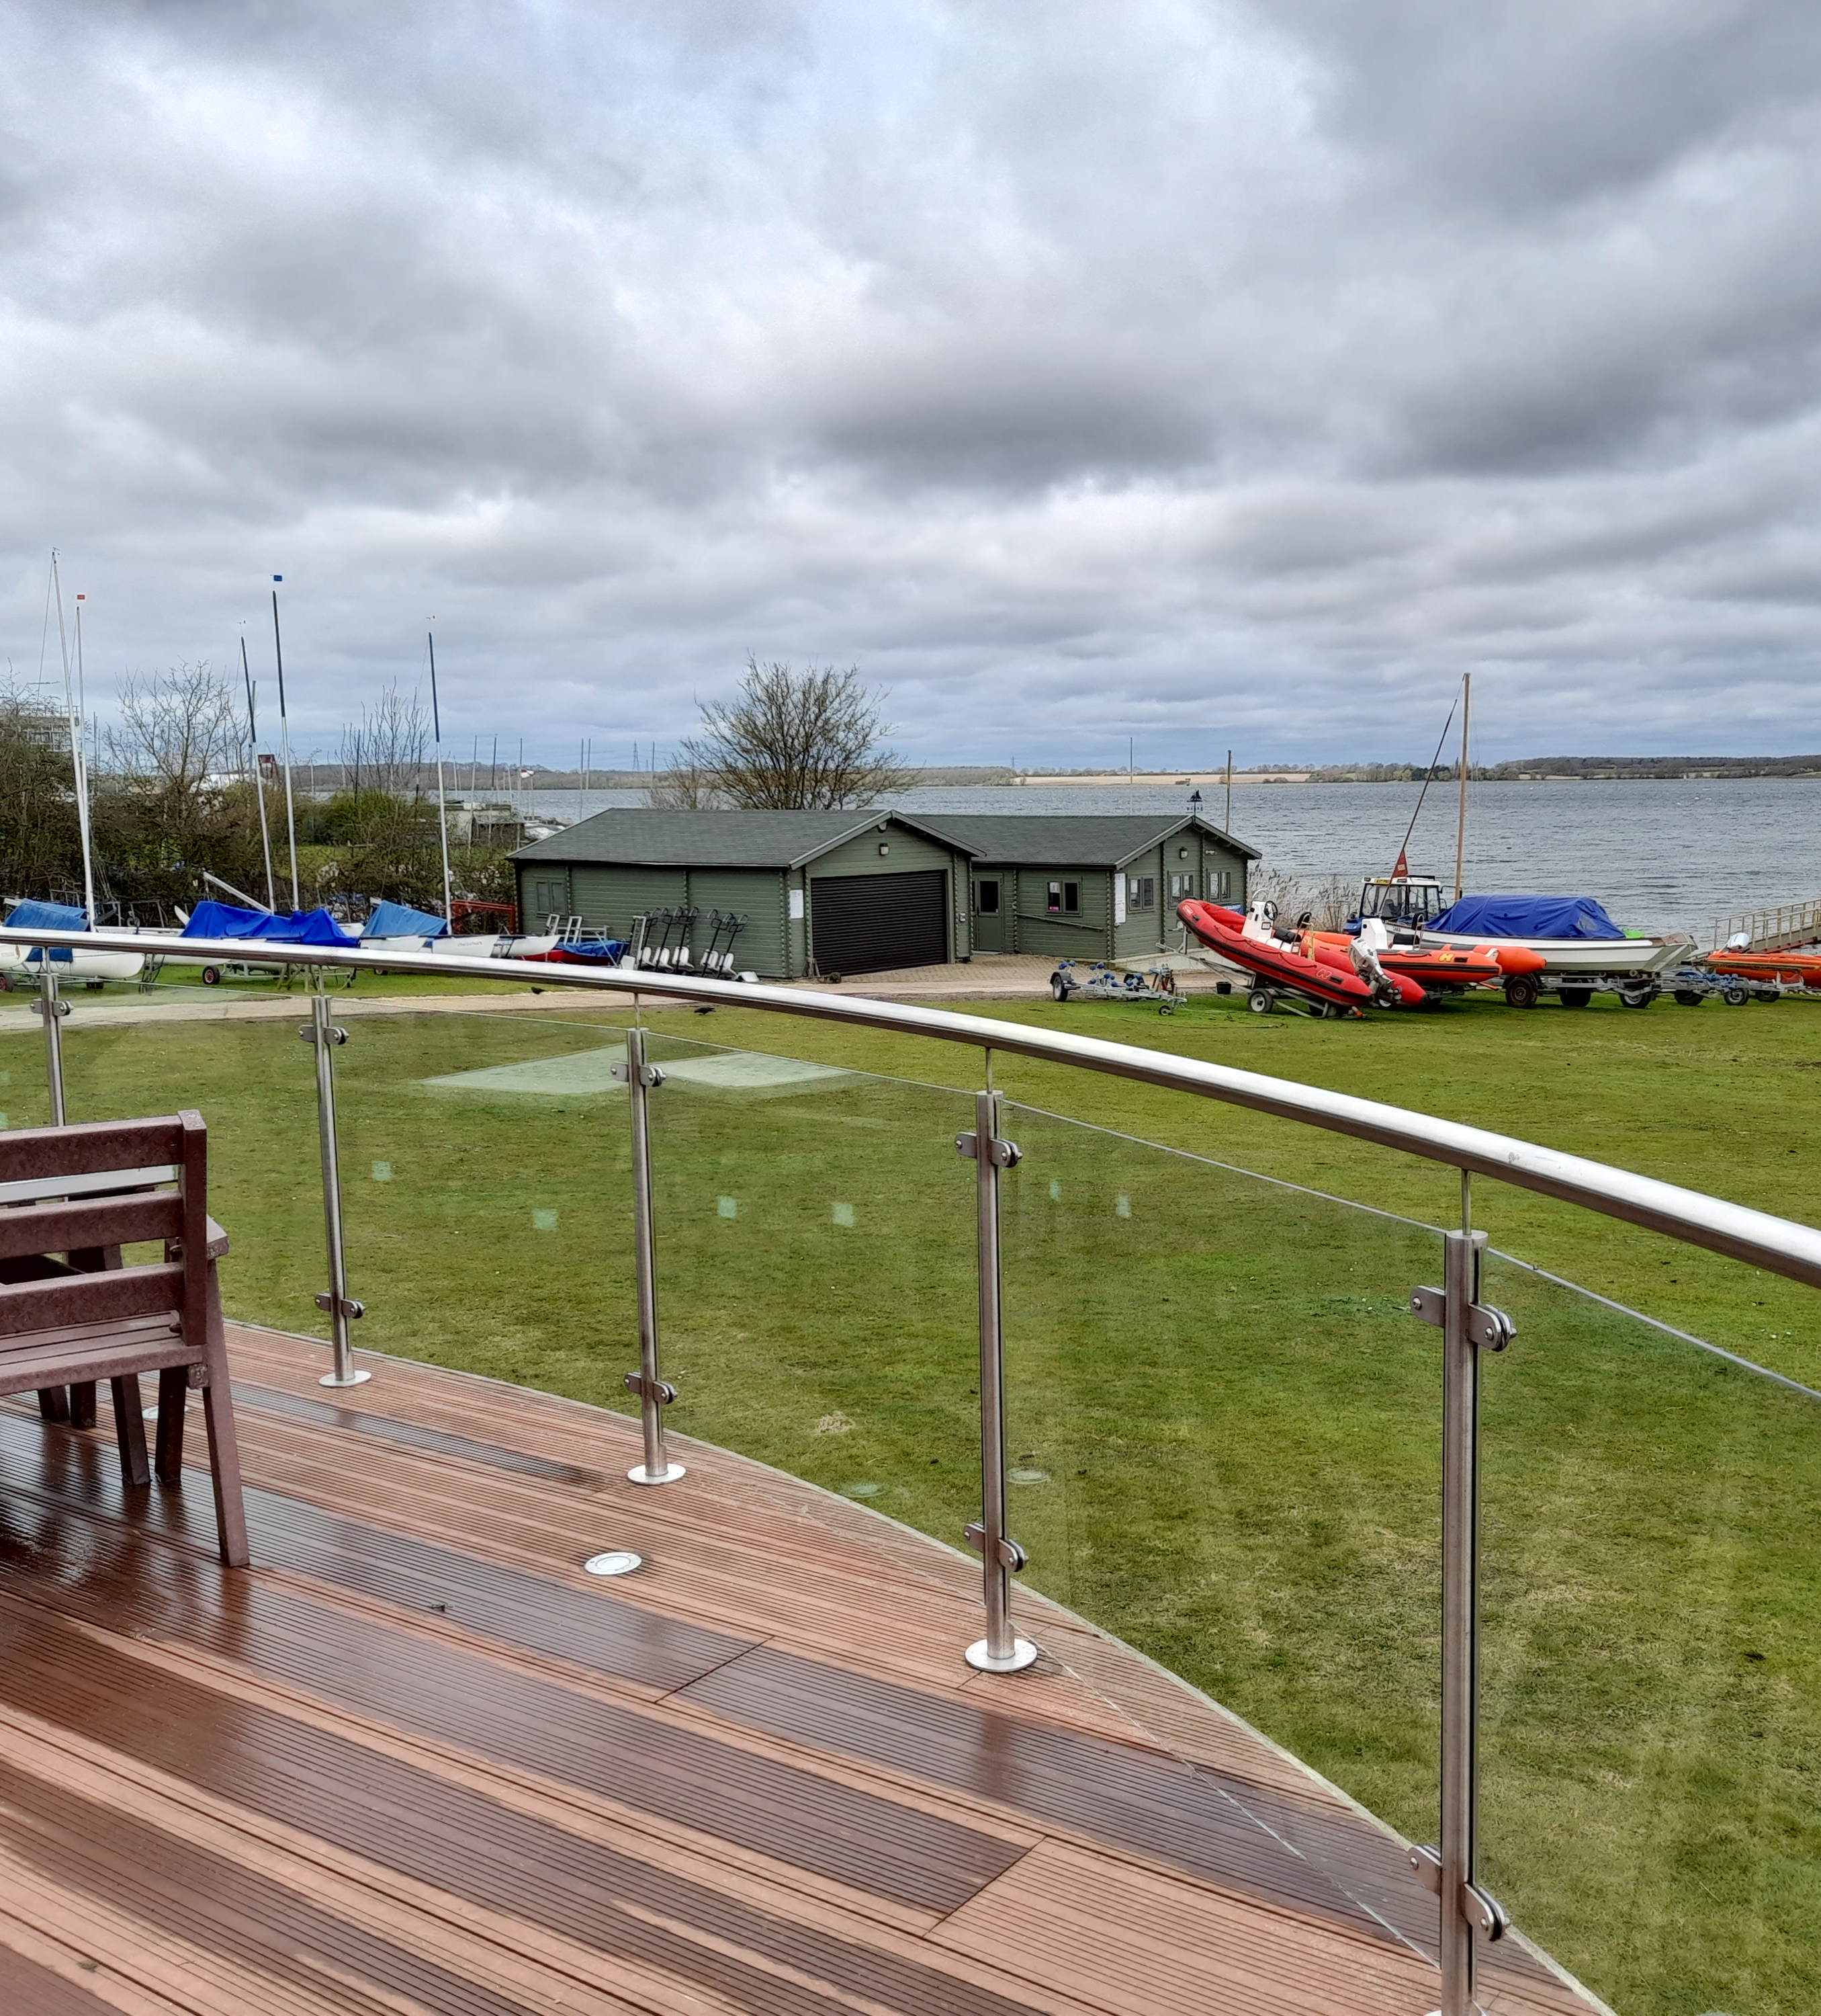
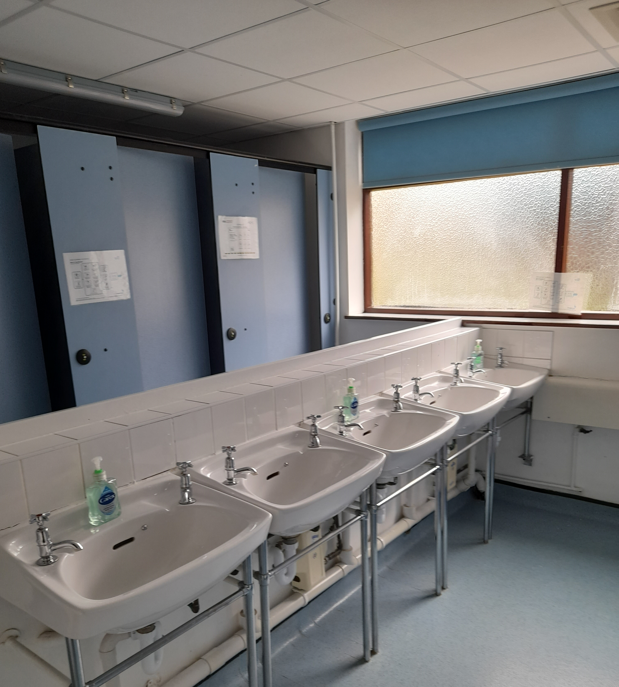
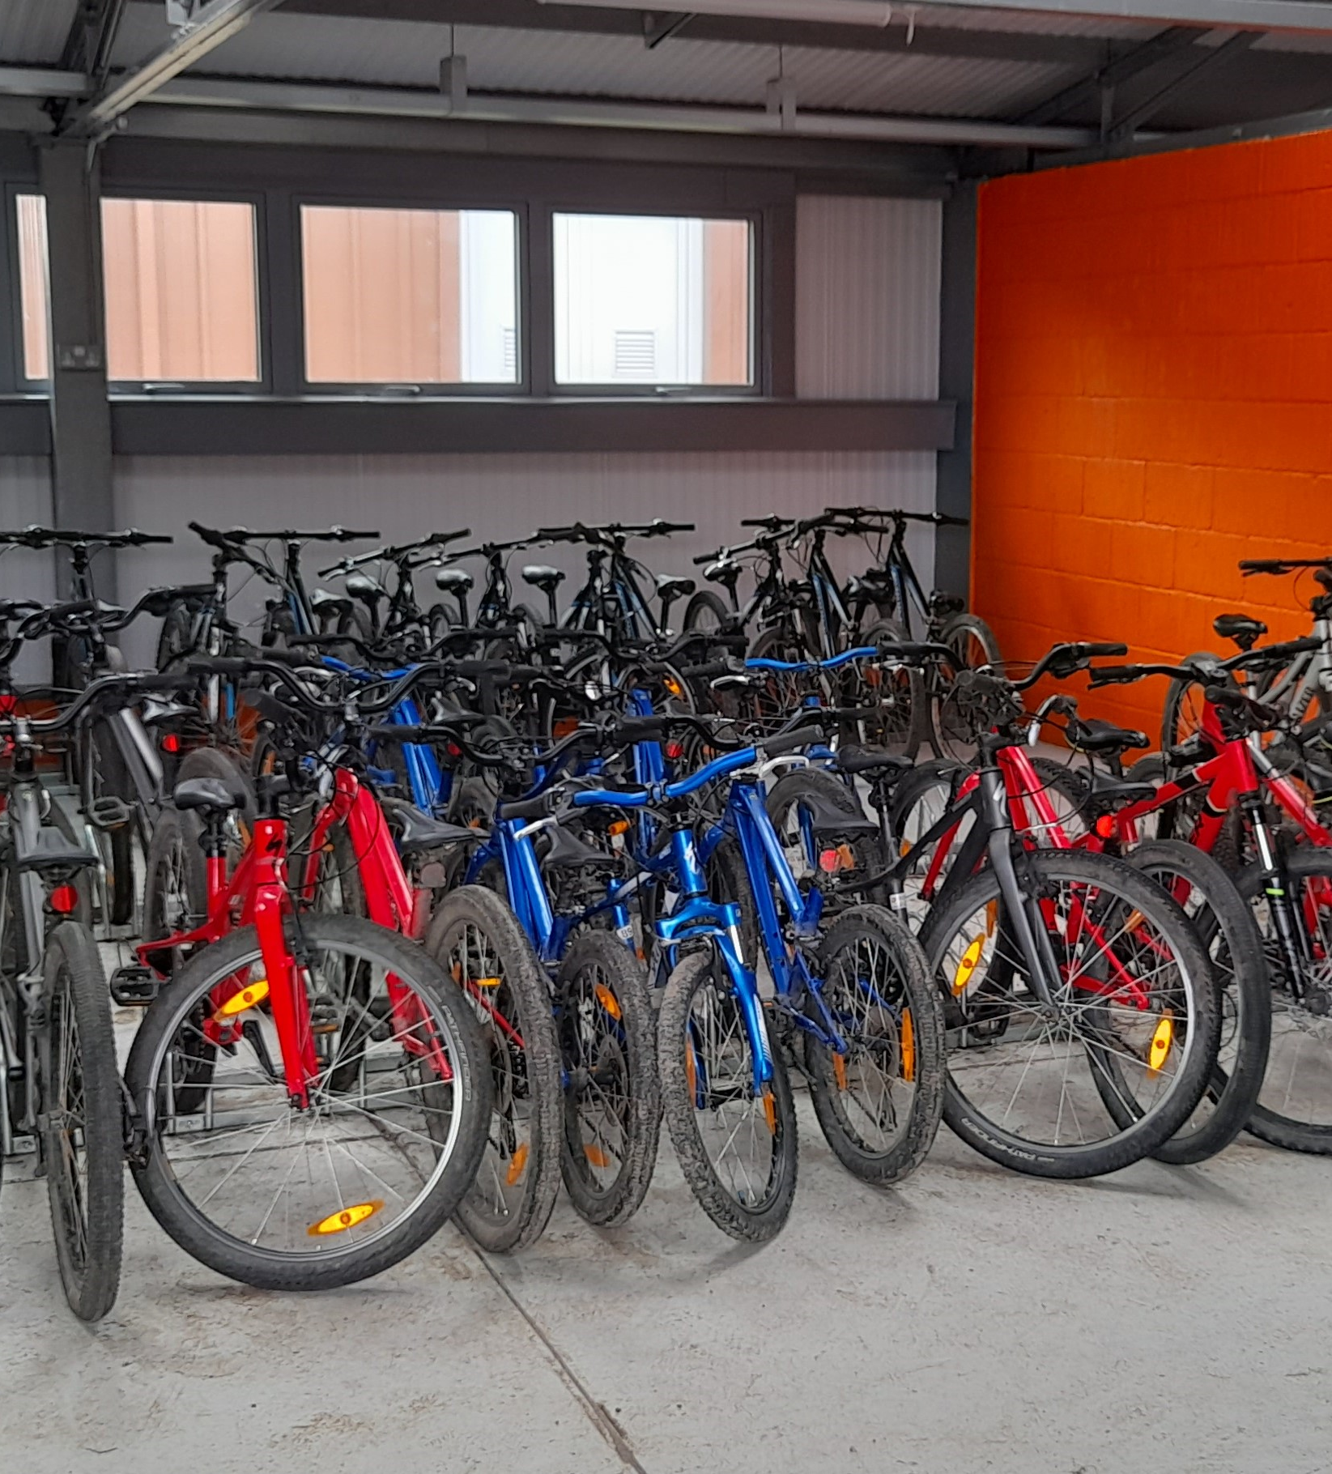
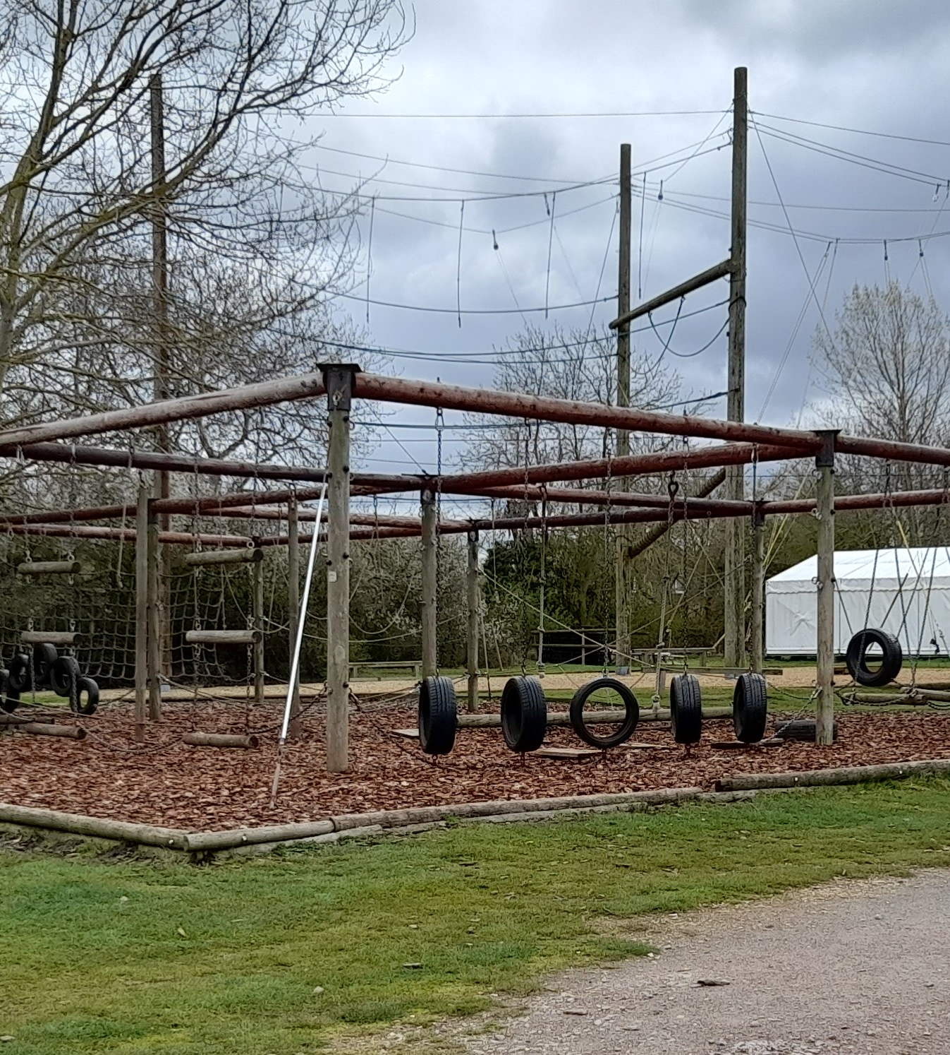

Slide 4
Monday 9th May 2022
8:45 when gates open come through to school hall (parents to say goodbyes in the playground as usual).
Medication to be handed to Mrs Reynolds
9:00am – children will be told their day groups and the coach will leave for Grafham at approx 9:30am.
10:00am arrive at Grafham. Rooms will be allocated when we arrive. Children have had an input.
Unpacking time and then lunch.
14:00 Afternoon activities start.

Slide 5
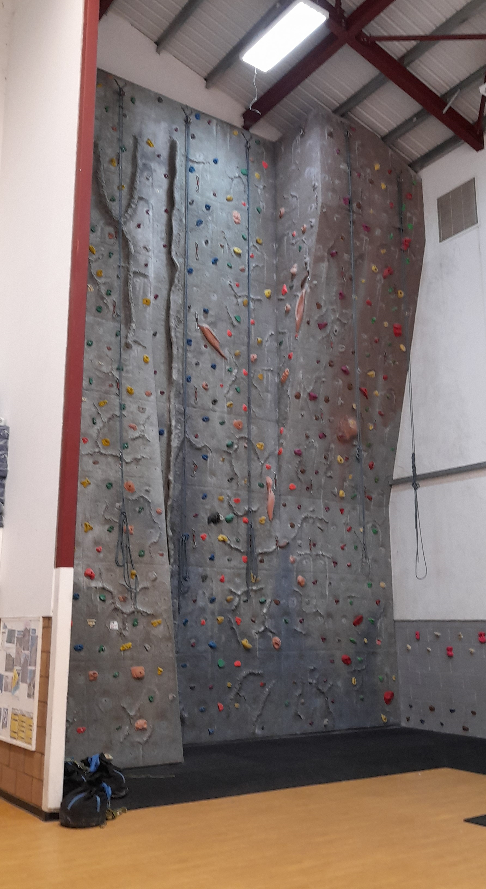
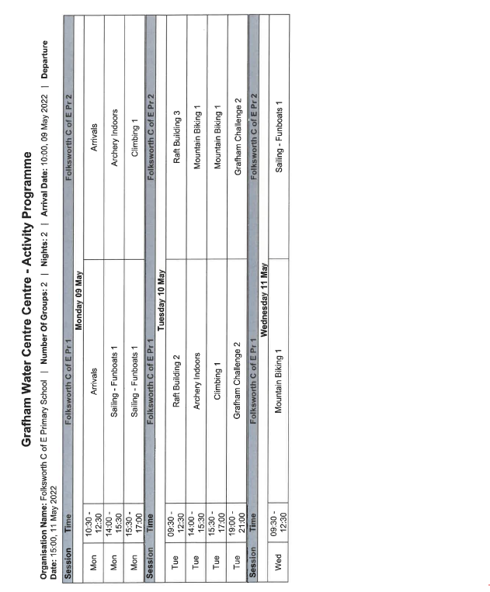

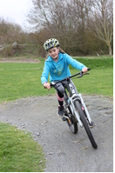

Activities

Slide 6
Wednesday 11th May
Depart Grafham at 2:00pm
Return in time to be collected as usual at the end of the school day.
Regular updates throughout visit on Twitter/ website including expected return time if delayed.

Slide 7
Packing List
Full Kit List attached
Please ensure your child has:
A suitcase they are able to lift
Waterproof coat
Appropriate clothing for the weather
Towel(s)
Toiletries
Clothes and shoes for water activities (not jeans)
Bedding is provided
You may also wish to include:
A disposable camera
(digital cameras will be the child’s responsibility)
Up to £5 spending money
(please hand to Mrs Perry in a named envelope).
A book/ suitable magazine to read
Cuddly toy
Please do not send:
Extra food and sweets
Mobile phones
Electrical items
Aerosols

Slide 8

Questions…?

